Slide 1
Gold Market Analysis and Price’s Prediction
Hamoye Internship Premium Project - Metadata Team

Slide 2


Our Team
Active Collaborators
Ekoue LOGOSU-TEKO
Project Presenter
Munachimso Ukaoha
Project Presenter
Name | Role / Activity
Ekoue LOGOSU-TEKO | - Data Wrangling - Machine Learning
Gospel Mairo | - Data Analyst
Munachimso Ukaoha | - Data Wrangling
Project Lead
Ekoue LOGOSU-TEKO
Assistant Project Lead
Gospel Mairo
Query Analyst
Munachimso Ukaoha

Slide 3
Problem statement
The price of gold is a volatile commodity and it is difficult to predict. Emerging world economies, such as China, Russia, and India have been big buyers of gold, whereas the USA, South Africa, and Australia are among the big seller of gold. The prices of other precious metals and crude oil can also affect the price of gold.
The goal of this project is to build a model that can predict gold adjusted closing prices with a high degree of accuracy. This model will be used by investors to make well-informed decisions about when to buy or sell gold.

Slide 4
Existing solutions
Some existing solutions include:
GoldPriceForecast.com: This website provides gold price forecasts based on technical analysis.
Investopedia: This website provides articles on technical analysis and fundamental analysis.
Quandl: This website provides historical financial data that can be used for technical analysis and fundamental analysis.
Google Cloud Platform: This platform provides machine learning tools that can be used to build models that predict gold prices.

Slide 5
Our approach
Divided work into tasks
Data Collection
Data Wrangling
EDA
Model Development
Model Deployment
Work was assigned on a volunteering basis whereby each collaborator choose what he wanted to work on.
Work was coordinated through team meetings and one-on-one meetings.

Slide 6
Dataset description
Dataset come from kaggle
Raw data have 1700+ samples for 84 features
Cleaned and tidy data was delivered after Data Wrangling
Many features (with high colinearity) as well as outliers were dropped during Model Development

Slide 7
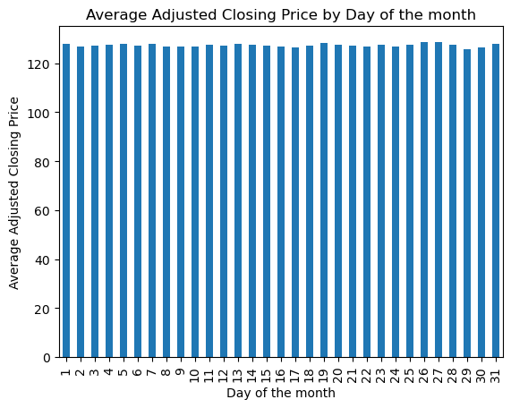
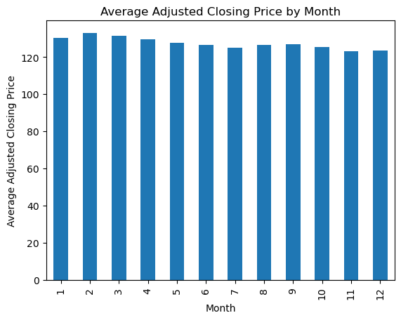
EDA
We found that gold prices are relatively stable, as shown in the plots below. This small variation explains why gold can be used to guarantee states' solvency. It also explains why we obtain good results in our model despite having a very small amount of samples (1700+).

Slide 8
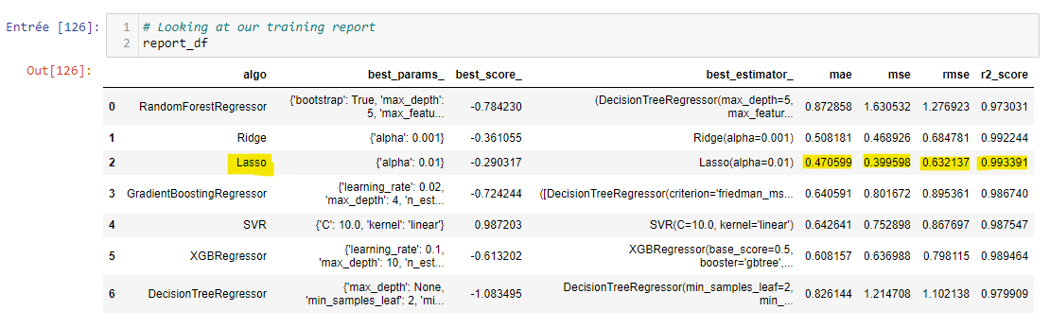
Model Development
We experimented with many Machine Learning algorithms, evaluated their results, and chose the best (Lasso) to train on the dataset.

Slide 9
Summary
Main observation: Gold prices are very stable, with a very small fluctuation range.
Challenges:
Time management: The team did not have enough time to work on model deployment.
Team Management:
Many collaborators were not active (23 out of 26).
Active Collaborators could have been better coordinated in their work
Many people were having issues adapting to working with Slack.
Recommendations:
Better match collaborators in a team: It would be good to filter out those who are not interested in being active before forming a team.
Have a senior from Hamoye in each team: This could help by giving general directives/advices on the work.

